Slide 1
SKB dongle
RFP

Slide 2
Revision history
V2
p.44,45: changed RCU, but still need ALT's confirmation.
p77,p.78: Add GOTA
p.83 Add Vietnam
p49/51-53: Add WiFi module spec., Flash reliability & CPU benchmark test

Slide 3





2.2 Company Status: Foxconn Industrial Internet (Fii) Company introduction
1.2.1. General Information
Automated Unmanned
Factories
Countries
Employees
Patents
Professionals
1.2.2. Business History
Foxconn becomes the governing unit of “Alliance of Industrial Internet”(AII) , “china mobile IoT alliance“ and customization industry alliance
Fii announced to build an “Industrial Internet Ecosystem”
Fii selected as 1 of 16 World Economic Forum’s (WEF)advanced manufacturing “lighthouses” factories.
Fii concept is born
2013
2015
2017
2019
Fii invested LUSTER, a machine vision company, and Digiwin, a digital solution provider, aiming to further ecology and expand capacity scope in Industrial Internet.
2014
2016
2018
2020
Set up a project team to prepare for industrial internet
Fii platform at Beijing Industrial Internet Alliance Conference
Fii listed on A share on Shanghai Stock Exchange
Foxconn Confidential & Proprietary

Slide 4
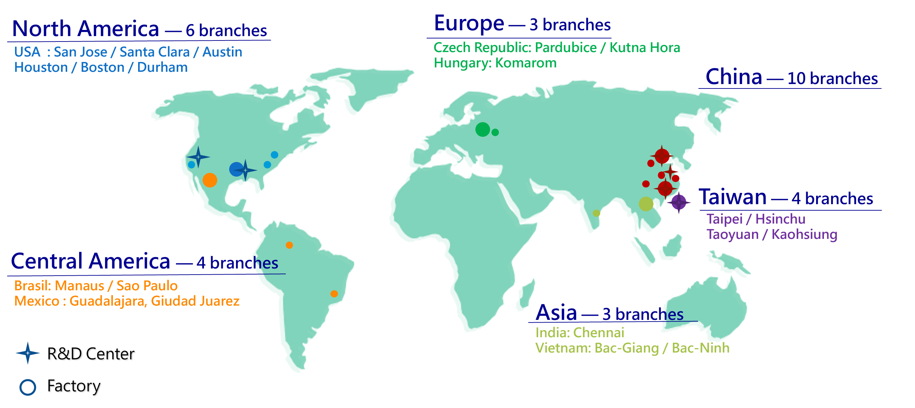
2.2 Company Status: Fii major business sectors: FG Group Branch
North America － 3 branches
USA : San Jose / Santa Clara / Houston
China － 6 branches
Nanning / Long-Hua /
Song-Jiang / Guanlan /
Hang-Zhou / Chong-Qing
Brazil: Manaus / Sao Paulo
Mexico : Guadalajara / Giuded Juarez
Foxconn Confidential & Proprietary

Slide 5
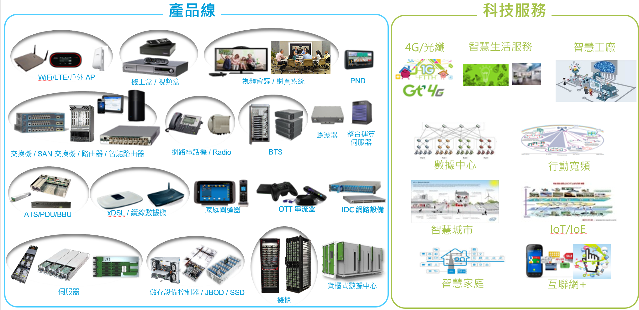
2.2 Company Status: Fii major business sectors
Products
Services
4G/ Fiber
Smart Life
Smart Factory
Wifi/ LTE/ AP
STB
TV Conference
PND
Filter
Integration
Server
Switch/ Router/ Smart Gateway
IP Phone/ Radio
BTS
Data Center
Mobile Broadband
ATS/ PDU/ BBU
xDSL/ Modem
Home Gateway
OTT
IDC device
Smart City
IoT/ IoE
Server
Containerized Data Center
Smart Home
Internet +
Storage Controller/ JBOD/ SSD
Rack
Foxconn Confidential & Proprietary

Slide 6
2.2 Company Status: Android TV Team Org(Sales and HW/SW Team)
Premium
Advance
Intermediate
Beginner
Kevin Liu/Peter Lan
BU Head, 25yr/27yr
500+ RD engineers.
TW, VN, CN, JP, KR, USA
15+ team member.
Target to grow to 20+ members in 2021.
TW, VN, CN, JP, KR, USA
Vincent Tung
Rick Chen
200+ team member.
TW, VN, CN, JP, KR, USA
Sales/PM head,21yr
R&D head, 28yr
40+ ATV team member.
Target to grow to 60+ members in 2021.
Jacky Chiang
Sean Chiang
10+ ATV team member.
Target to grow to 20+ members in 2021.
Software RDPL/ 20yr
Hardware RDPL/ 19yr

Slide 7
2.2 Company Status: Android TV Team Org(Engineering Support Team)
Wilson Kao
SQA leader,20yr
James Kuo
Senior engineer,20yr
Bryan Yang
Senior engineer,12yr
Beca Ding
Junior Engineer,2yr
D.A. Wei
Senior engineer,8yr
HW QA
SQA
Kenji Chen
HWQA leader, 18yr
Tommy Chen
Senior engineer, 13yr
Leif Lin
Senior engineer, 12yr
Premium
Advance
Intermediate
Beginner
10+ team member.
10+ team member.
ME
Package
Layout
Compliance
Charge Tseng
ME leader,20yr
Ace Liu
Senior engineer,5yr
Andy Qin
Layout leader,16yr
Ming Rong
Senior engineer, 6yr
Enya
Senior engineer, 7yr
Jason Kung
Compliance leader, 19yr
Jonah Lee
Senior Engineer, 16yr
Wen Chao
Senior engineer, 8yr
Allen Chang
Package leader, 16yr
Lydia Liu
Senior engineer, 4yr
Aglaia Lee
Senior engineer, 5yr

Slide 8
2.2 Company Status: Android TV Team Org(MFG)
CFT team from VN Factory
Premium
Advance
Intermediate
Beginner
David Yin
MFG site manager,16yr
Ben Trinh
MFG Lead, 12yr
Bi
CFT NPI PM, 10yr
Nelly
CFT MP PM, 2yr
Lam Chu
PM lead, 11yr

Slide 9

2.2 Company Status: Patent
STB related
WiFi related

Slide 10
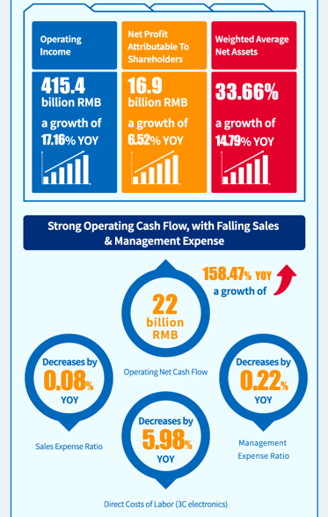
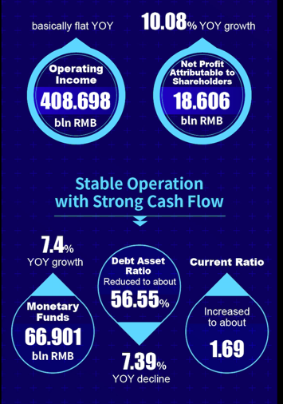
2.2 Company Status: Financial statements
2018
2019
Reference link:
http://www.fii-foxconn.com/static/file/032919_content.pdf
Reference link:
http://www.fii-foxconn.com/static/file/%E9%95%BF%E5%9B%BE.jpg

Slide 11
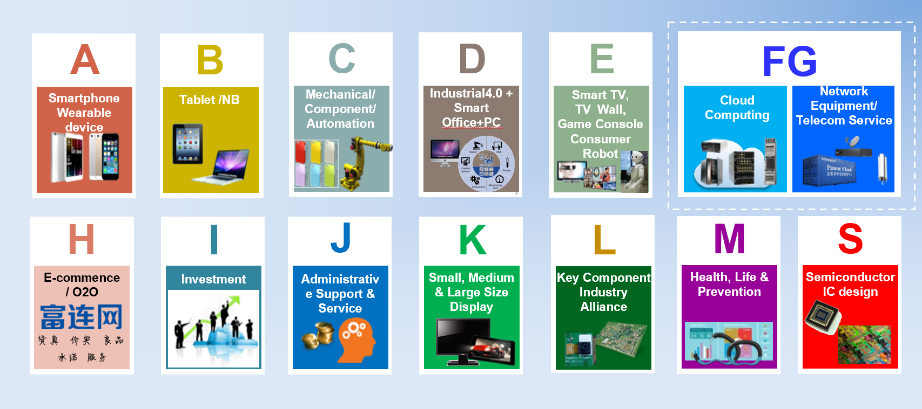
2.2 Company status - Subsidiary or affiliated company
Mother company: Honhai precision Ltd’s main business sectors
(Fii)
Hon Hai Precision
鴻海精密 2317.TW
FIH Mobile Limited
富智康 2038.HK
FIT HON TENG
鴻騰 6088.HK
Fii 工業富聯 601138.SH
Foxconn Technology
鴻准 2354.TW
Foxsemicon
京鼎 3413.TW
Ennoconn
樺漢 6414.TW
Asia Pacific Telecom
亞太電 3682.TW
A
L
A
C
C
FG
FG
ShunSin
訊芯 6451.TW
ESON
乙盛 5243.TW
SHARP Corporation
夏普 6753.TO
CyberTAN
建漢 3062.TW
MTI
台揚 2314.TW
Zhen Ding
臻鼎 4958.TW
AOT
榮創 3437.TW
Innolux
群創 3481.TW
E
E
E
FG
FG
L
L
K
Foxconn Confidential & Proprietary

Slide 12








2.3 Related technology and supply performance
HWQA Reliability Test Items
Climatic Test
Thermal Profile test
Cold / Hot Start Test
Continuation of temperature cycle
EDVT
Temperature and humidity cycles test
High Temperature & Humidity Test (Op)
Operational Temperature Range
Power on/of f with Temp.
Quicky Power on/off Test
RDT Test
MTBF Prediction
HALT Test
Reliability
Mechanical Test
Vibration Test Random (Op)
Shock test (Op)
Label Adhesion Test
Abrasion Resistance of Label Test
Logo/Printing Abrasion Test
Non-operating drop test
Salt Spray Test
Connector Life Test
Button Life Test
Reliability Standard:
IEC60068 for Environmental
ISTA-2A for Package test
3rd Party Lab.: Orange color
Package Test
Temperature and Humidity Test
Static Compression Test
Random Vibration Test
Free Fall Drop Packaged
Fix Displacement Vibration Test

Slide 13
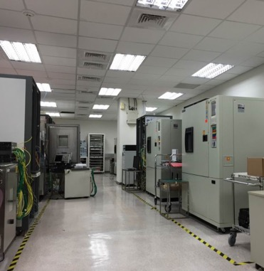

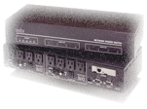

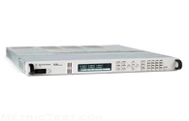
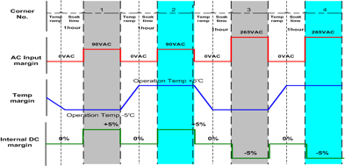
2.3 Related technology and supply performance
HWQA Capabilities – EDVT
EDVT
Electrical Design Verification Test
Verify the hardware design by exposure of the product to wider temp & voltage margining.
Temperature Margin: Min Op. Temp – 5’C ~ Max Op. Temp + 5’C
Voltage Margin DC: All Power Rail +/- 5%
Voltage Margin AC: 90VAC /47Hz & 264VAC / 63Hz
IXIA
Power Cycle Box
DAQ
EDVT Lab
Power Supply

Slide 14



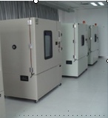

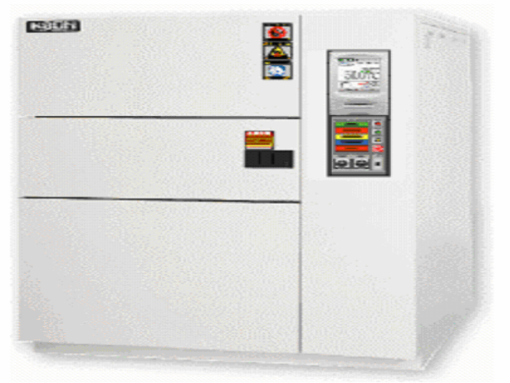
2.3 Related technology and supply performance
HWQA Capabilities – MDVT
MDVT
Mechanical Design Verification Test
ＭＤＶＴ
MDVT is comprised of dynamic (mechanical) and environmental tests. These combination of op. and non-op. tests.
Thermal Profile Measurement
Environmental Test – High/Low Temp/Hum., Altitude, UV, Rain, Dust, Salt spread…etc.
Mechanical Test - Vib & Shock, Drop, button life, cable..etc
Package Test – ISTA-2A, 3A
Product Reliability: MTBF Prediction/ demo., thermal shock…etc.
Test to failed – HALT, HASS
Thermal Chamber
Drop Tester
Shock Tester
Env. Chambers
HALT
Vib. Test for Rack
Thermal Shock

Slide 15


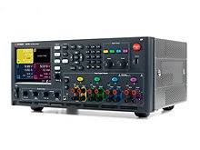

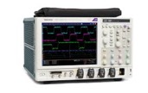
2.3 Related technology and supply performance
HWQA Capabilities - SI Meas.
SI
Signal Integrity Measurement
A dedicated team to work on a set of measures of the quality of an high-speed electrical signal.
IEEE802.3 10M/100M/1G/10G/2.5G/5G/40G/100G/400G Compliance Test
SFP+/QSFP+/QSFP+100 Compliance Test
DDR I/ II/ III/IV/IVLE Signal Test
UDB3.1/HDMI/PCIe/SATA
DC/DC, AC/DC, PoE
Clock Phase Noise
….etc.
Keysight 86100D
DPO71604C
Keysight N6705C
MSO72304DX
400G SI Test
Keysight 86100D

Slide 16
2.3 Related technology and supply performance
MDVT
SI
HWQA Test
EDVT
Test
Standards
IEEE 802.3
SFF-8431
JEDEC 79-4A
IEC 60068-2
MIL-STD
NEBS GR-63 CORE
Telcordia SR-332
ISO7779
ISTA – 2A

Slide 17
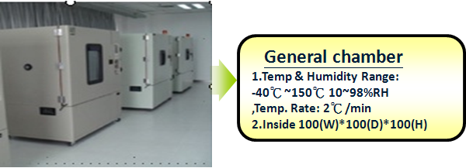
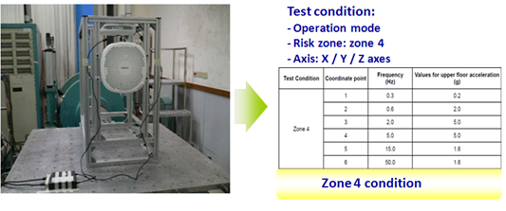
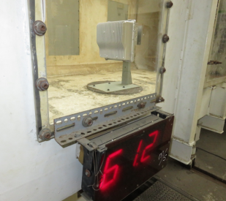
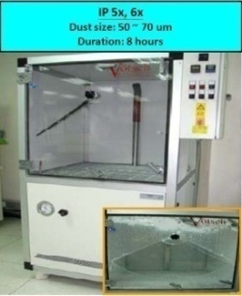
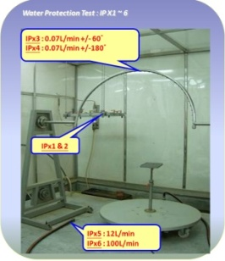
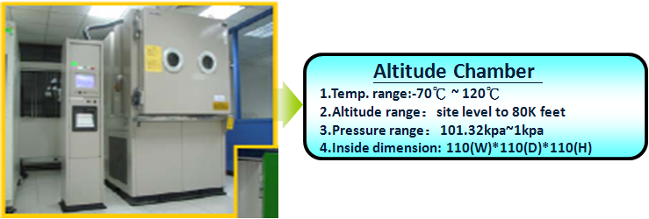

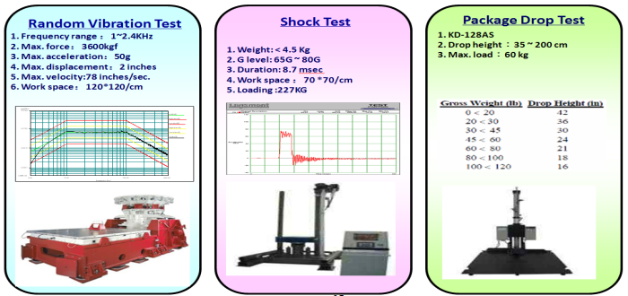
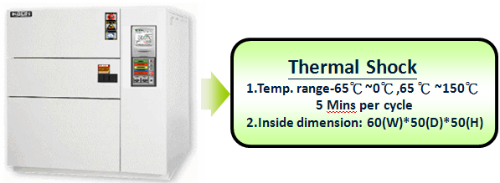

2.3 Related technology and supply performance
HWQA Capabilities
(1) General chamber:
(4) Earthquake (zone 4 level):
(7) Wind loading test: 61.2 m/s (wind level 17: strongest typhoon)
(5) Dust & water protection (IP65):
(2) Altitude chamber:
(8) Salt fog test: 5% salt, 35℃
(3) Thermal shock:
(6) Package test machine:
(9) Solar test:1120 w/m², 55 ℃

Slide 18

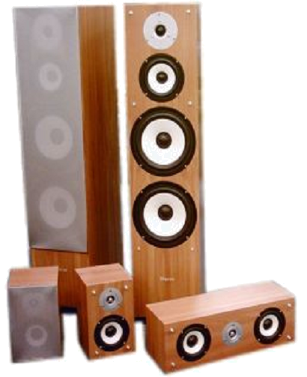











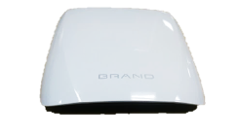
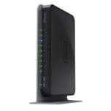









OTT Box Test Environment
2.3 Related technology and supply performance
Subjective Test
Video Streaming
TV Sets
Sony, Panasonic, Toshiba, Sharp ...
Internet
Speakers
HDMI
Composite
Component
Traffic Jitter/Delay/ Drop
- Shunra Storm
Dolby AV Receiver
Ethernet
Ethernet
Peripheral Test
WiFi
802.11 b/g/n/ac
WEP/WPA/WPA2
AP
Remote
Controller
Ethernet
OTT Box
Objective Test
Audio Analyzer
- AP APX585 & AP2722
Picture Analyzer
- Video Clarity ClearView
HDMI Protocol/CEC Analyzer
- Quantum Data 980 / 882E
Digital Serial Analyzer
- TEK DSA71604B
Notes:
RCU’
DUT換成EAGLE

Slide 19
Wi-Fi Development Process (1/5)
2.3 Related technology and supply performance
Conducted test
Antenna test
Radiation test
Design prepare
OTA test
Wi-Fi spec. review
  Transmit power
  Frequency Band
Wi-Fi solution
  Interface : SDIO
  Chipset vendor : REALTEK
Locating Antenna position in STB
  Mechanical drawing
  Simulation(HFSS)
  RF cable path
Schematic and Layout reviewed by vendor

Slide 20
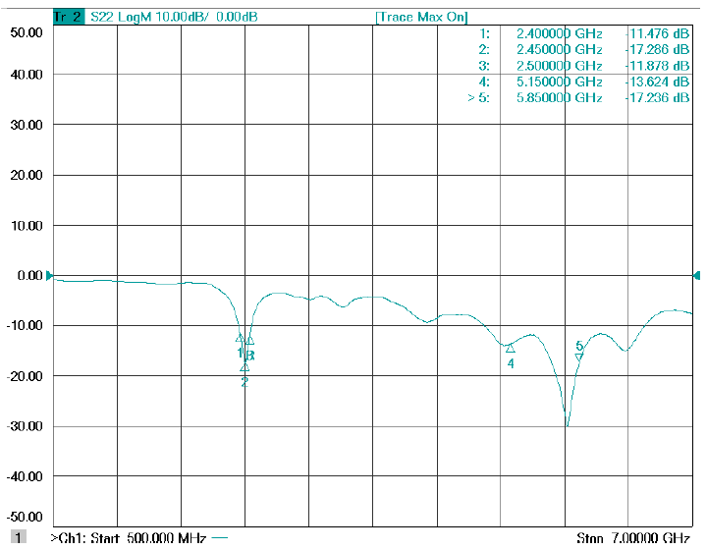
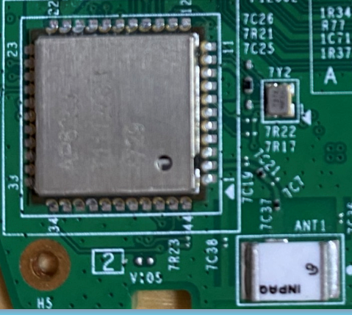
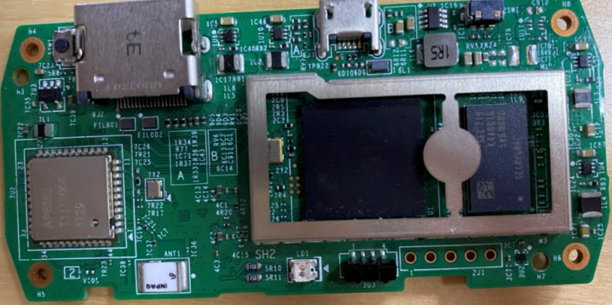
Design prepare
2.3 Related technology and supply performance
Simulation (HFSS)
Return Loss
Mechanical drawing
This picture is only for reference.
WIFI module
RF path
Chip antenna
Efficiency
Chip antenna | 5.15G | 5.47G | 5.85G
Efficiency(%) | 63.36 | 66.20 | 63.51
WIFI
module
SOC
* Above is reference data, need to use actual PCB to test

Slide 21
Wi-Fi Development Process (2/5)
2.3 Related technology and supply performance
Conducted test
Antenna test
Radiation test
Design prepare
OTA test
802.11a/n/ac Spec. verification
  Transmit power measurement
  Transmitter spectral mask test
  Transmitter spectral Flatness
  Local Oscillator suppression & Center frequency tolerance
  Transmit Center Frequency Error
  Transmit Power On and Power Down Ramp
  Transmit modulation accuracy (EVM)
  Receiver minimum input level sensitivity
  Receiver maximum input level
  Adjacent channel rejection and Non-adjacent channel rejection
Chipset vendor review Conducted performance

Slide 22
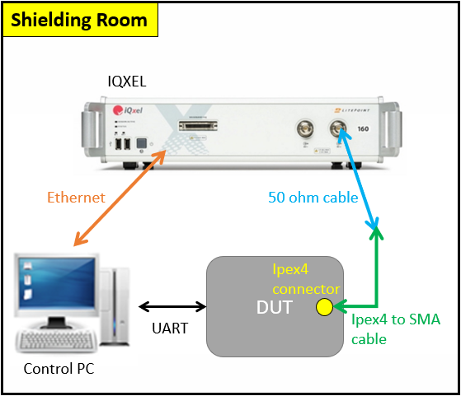
Conducted test
2.3 Related technology and supply performance
Test Step
DUT install RF test tool of module
Control PC connect IQxel or others equipment via Ethernet
Connect DUT and IQxel by 50 ohm cable and Ipex4 to SMA cable
Setting parameter by IQxel
Setting parameter by RF test tool and start test
Repeat step4 and step5
Test diagram
Test equipment list
 | Q’ty
Control PC | 1
IQxel | 1
Ethernet cable | 1
50 ohm cable | 1
Ipex4 to SMA cable | 1

Slide 23
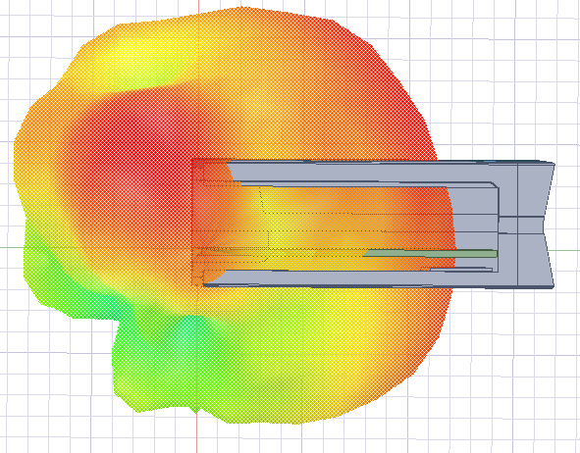
Wi-Fi Development Process (3/5)
2.3 Related technology and supply performance
Conducted test
Antenna test
Radiation test
Design prepare
OTA test
internal design target
  Frequency 5GHz: 5150 ~ 5350, 5470 ~ 5850MHz
  Directivity: ≥ +3dBi
  Efficiency: ≥ -50%
  VSWR: ≤ 2.0:1
  Return Loss : ≤ -10dB
Antenna passive test with mounting STB
  Antenna position: Simulation by using 3D antenna tool (HFSS)
  Antenna performance measurement in Anechoic chamber
The reason to reduce peak gain spec from +5dBi to +3dBi
Based on environment of dongle, expected to use chip antenna, but pattern design of chip antenna is fixed and the peak gain can’t be improved by adjusting antenna matching
Based on the design experience in previous project, the peak gain of chip antenna is about +3dBi
Peak gain of previous project
 | 5150 | 5470 | 5850
Peak gain (dBi) | 3.68 | 3.58 | 3.45
Antenna 3D plot
* Above is reference data, need to use actual PCB to test

Slide 24
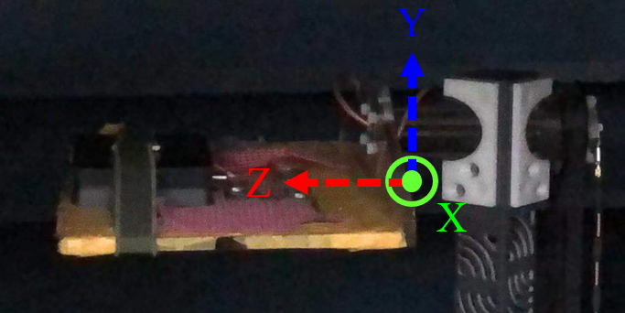
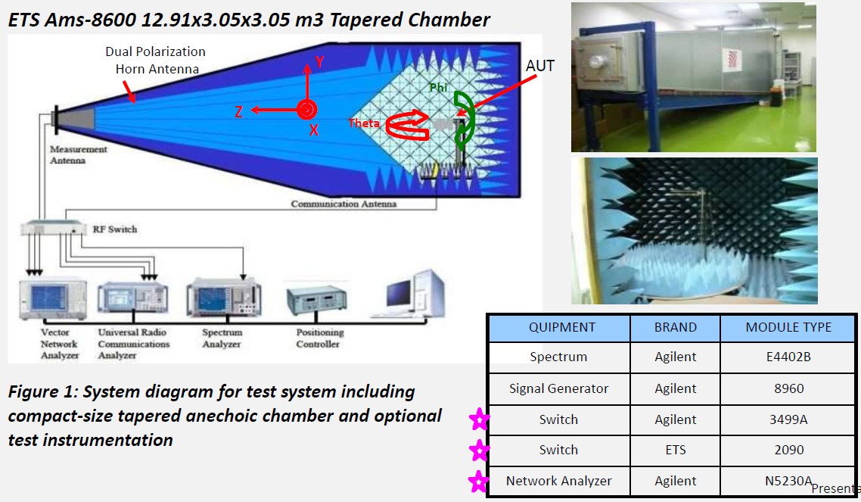
Antenna Test
2.3 Related technology and supply performance
Antenna Anechoic chamber
DUT
DUT
Test Step
DUT place on test platform
Parameter setting by test tool
Generate antenna gain, efficiency, 2D and 3D plot

Slide 25
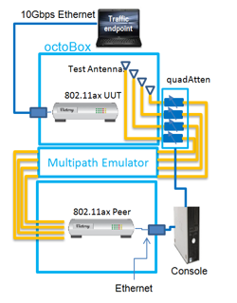
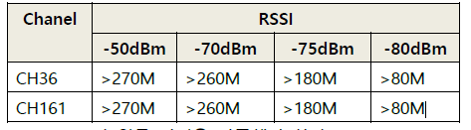
Wi-Fi Development Process (4/5)
2.3 Related technology and supply performance
Design prepare
Conducted test
Antenna test
Radiation test
OTA test
RvR(Wi-Fi Throughput Rate vs. Range in TCP) test
  Test Spec.:
  Test condition
  - In anechoic chamber or shield room
WIFI Throughput Tx/Rx test
- In anechoic chamber
(Suggest test criteria for next page)
Octobox environment setting
Please refer to radiation test page

Slide 26
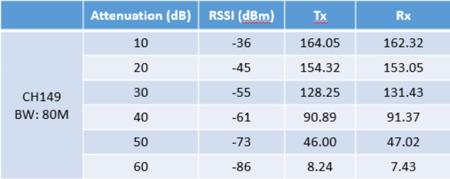
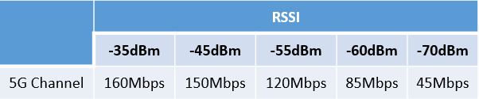
Test criteria
2.3 Related technology and supply performance
The following table is RvR test result using WIFI module (chipset : RTL8822CS), when the attenuation is 10dB, throughput less than 200Mpbs, so unable to meet over 270Mbps at -50dBm
Suggest test criteria
Because the throughput test result is related to the SOC, Therefore, it is suggest that the test criteria as below table
* Above is reference data, need to use actual PCB to test

Slide 27
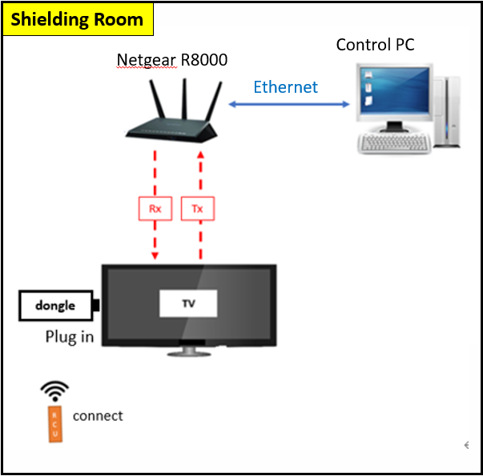
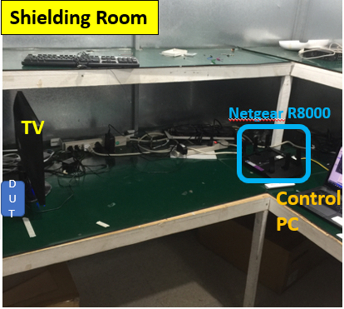
Radiation test
2.3 Related technology and supply performance
Test Condition : RCU pairing/RCU non pairing
5GHz (unit: 866Mbps) |  | Channel 36 | Channel 149 | Channel 161
RCU no pairing | Tx | 268 | 297 | 280
 | Rx | 256 | 256 | 257
RCU pairing | Tx | 265 | 293 | 277
 | Rx | 250 | 248 | 254
Test diagram
Actual test environment
Test Condition : RCU pairing + Play 4K Video
5GHz (unit: 866Mbps) |  | Channel 36 | Channel 149 | Channel 161
RCU pairing | Tx | 250 | 262 | 260
 | Rx | 236 | 256 | 237
Shielding room size
2.34m*2.34m*2.19m
* Above is reference data, need to use actual PCB to test

Slide 28
Wi-Fi Development Process (5/5)
2.3 Related technology and supply performance
Conducted test
Antenna test
Radiation test
Design prepare
OTA test
Indoor OTA test
  Test Spec.: Min. Throughput ≥ 20Mbps @spot No
  Test condition
  - CH36 @5GHz and CH161
  - Test spot on FXN TW office
Outdoor OTA test
  Test Spec.: comparison data for reference sample
  Test condition
  - CH36 @5GHz and CH161
- Test place where is non line of sight W/O WLAN AP
MP prepare
  Mass product automation program
  Manufacturing Spec. fix
Please refer test environment and procedure to next page

Slide 29
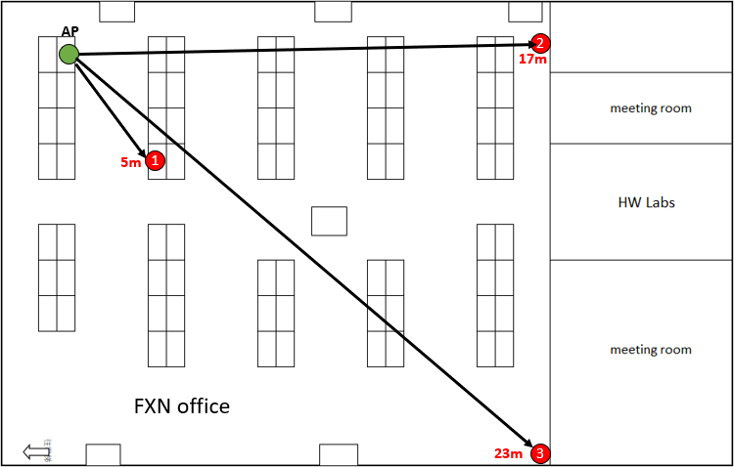
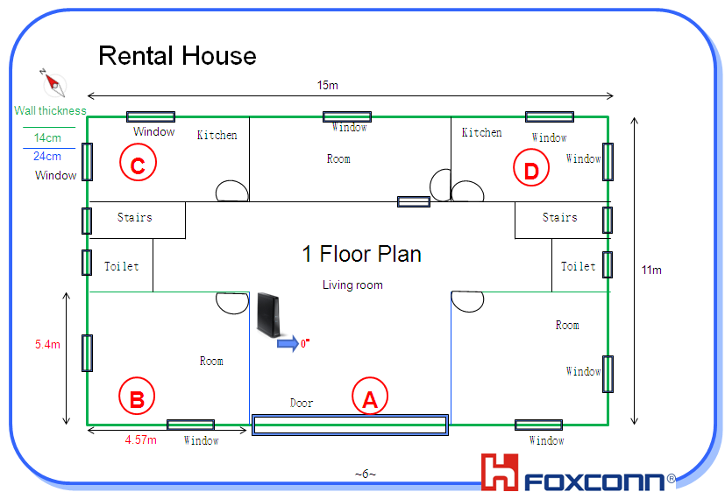
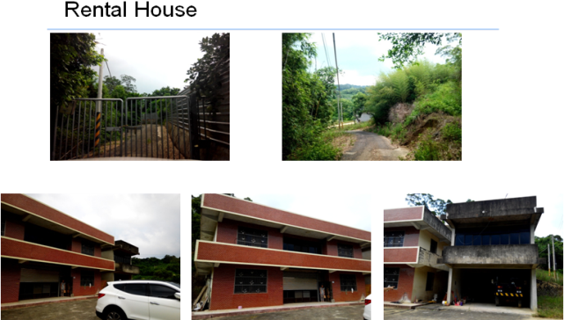
OTA test
2.3 Related technology and supply performance
Test Step for Indoor and Outdoor OTA test
DUT install Iperf3 client APK
The AP is placed at the green point in the picture
The DUT is placed at the red point 1 in the picture
Start Rx test
Repeat step 3 and step 4
Indoor
NLOS - Rental House Test
Live signal without neighbors’ WiFi interference
Outdoor

Slide 30
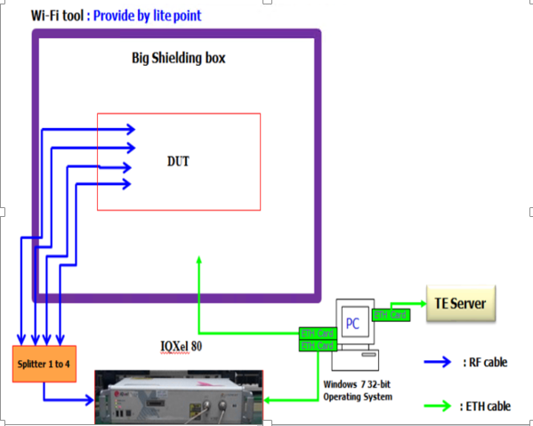
Wi-Fi Manufacturing Process (1/4)
2.3 Related technology and supply performance
Conducted test
Radiation test
Calibration
OBA test
Wi-Fi Calibration
Wi-Fi Verification(Conducted test)
Using IQxel80 or IQM8W
Description | Unit
PC | 1
IQxel80 or IQM8W | 1
RF connector | 4
RF cable | 5
Attenuator(10dB) | 1
Ethernet cable | 3
Shielding Box(Big) | 1
Fixture | 1

Slide 31
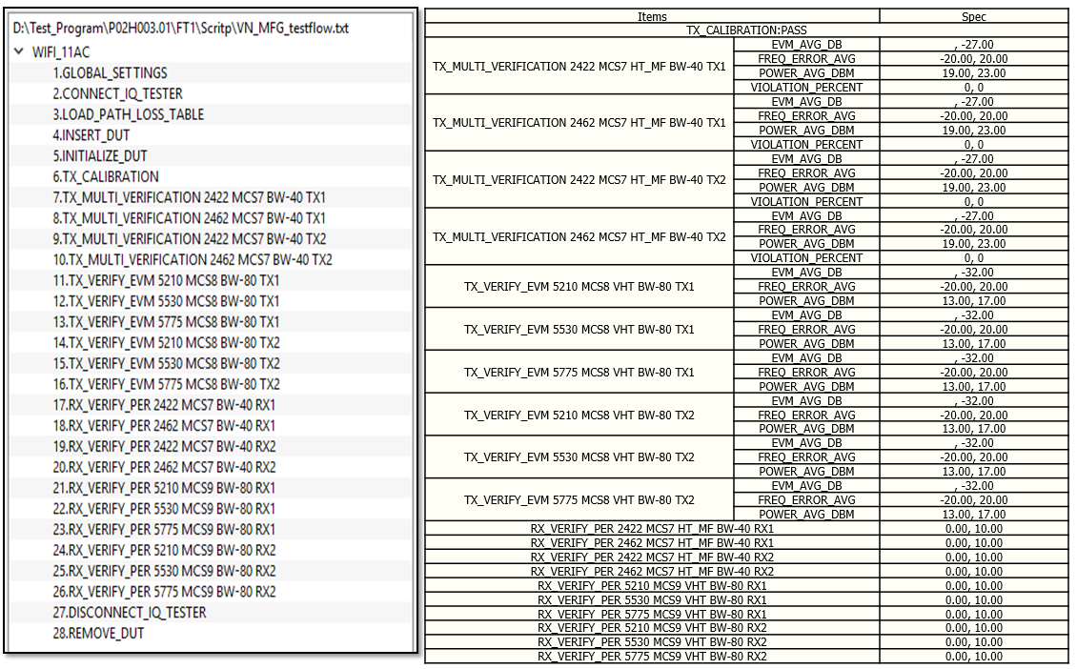
Wi-Fi Manufacturing Process (1/4)
2.3 Related technology and supply performance
Conducted test
Radiation test
Calibration
OBA test
Wi-Fi Calibration spec
  List up

Slide 32
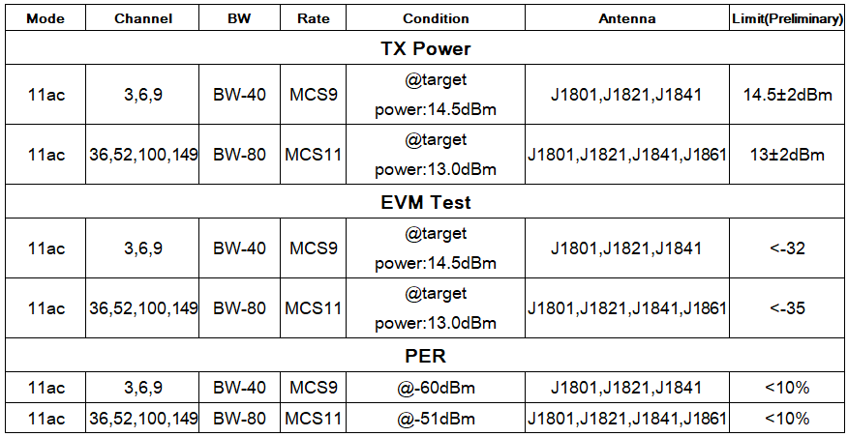
Wi-Fi Manufacturing Process (2/4)
2.3 Related technology and supply performance
Calibration
Radiation test
Conducted test
OBA test
WIFI Conducted test
  Test diagram
  Test spec
802.11a/n/ac . Frequency list, Test spec, Calibration & verification or only have verification
  Transmit power measurement
  Transmitter spectral mask test
  Transmit Center Frequency Error
  Transmit Power
  Transmit modulation accuracy (EVM)
  Receiver minimum input level sensitivity
  Receiver maximum input level

Slide 33
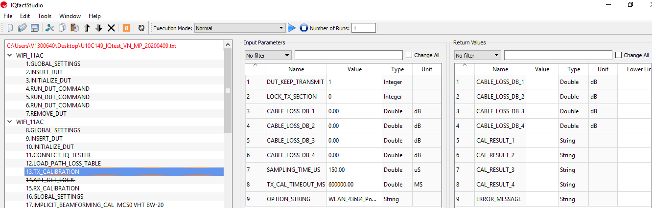
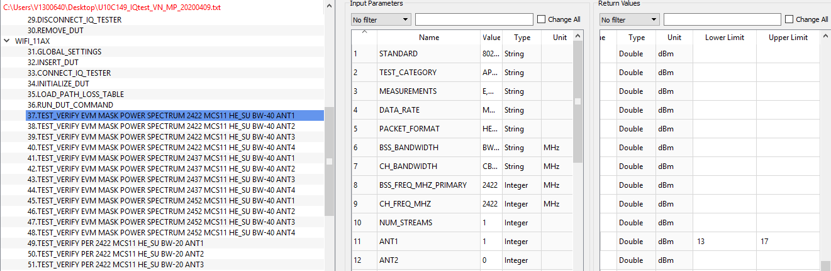

Wi-Fi Manufacturing Process (2/4)
2.3 Related technology and supply performance
Calibration
Radiation test
Conducted test
OBA test
WIFI Conducted test
  Test diagram
  Test spec

Slide 34
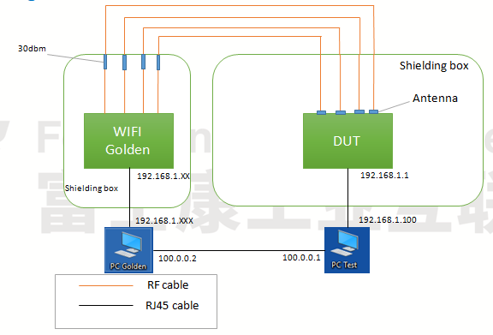
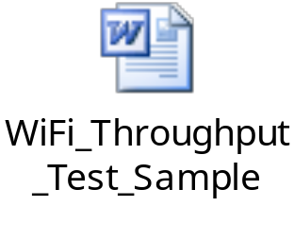
Wi-Fi Manufacturing Process (2/4)
2.3 Related technology and supply performance
Calibration
Radiation test
Conducted test
OBA test
Throughput test
  Test diagram
  Test spec

Slide 35
Wi-Fi Manufacturing Process (3/4)
2.3 Related technology and supply performance
Calibration
Conducted test
Radiation test
OBA test
WIFI Radiation test
  Test diagram
  Test spec
* ALT Comment : Please update mass production test diagram and test environment
* FXN : It’s the same with WIFI throughput test

Slide 36
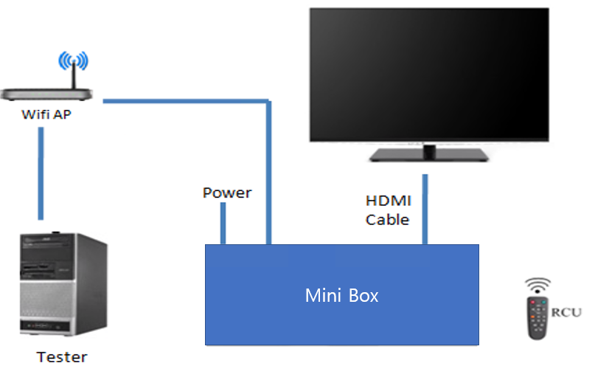
Wi-Fi Manufacturing Process (4/5)
2.3 Related technology and supply performance
Calibration
Conducted test
OBA test
Radiation test
WIFI OBA test
  Test diagram
  Test spec->Connect internet and play YouTube content
* ALT Comment : Please update mass production test diagram and test environment

Slide 37

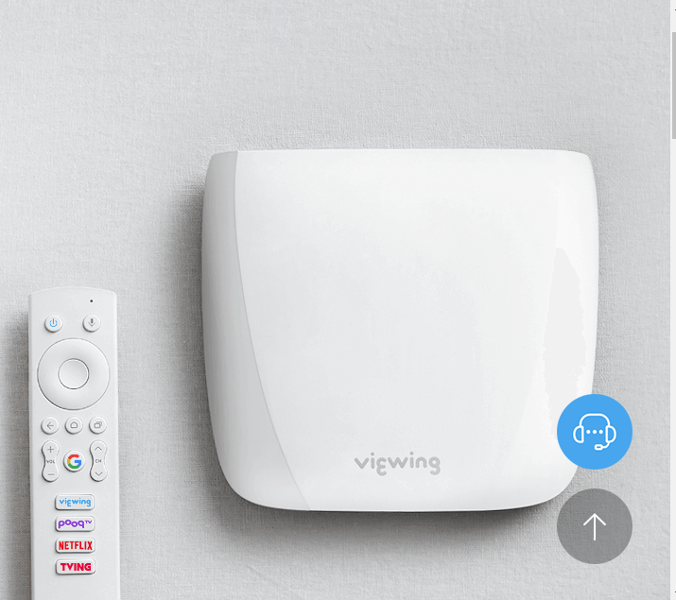
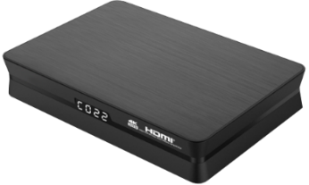






2.3 Related technology and supply performance
Android TV OTT box related development experience and major supply performance/commercialization cases in the last 3 years
Fii works with worldwide 1st Tier Brand companies: Google, Amazon, Roku, Technicolor, Commscope, SHARP, etc for worldwide carriers.
Over 15 million STB delivered per year
Over 30 million OTT delivered per year
Over 600K ATV STB delivered per year
Operating profit is around 2%
Simple H/W & S/W Spec by model, supplier, supply quantity, commercialization must be included
SKB
Shipped 1KK+
BANDOTT
Shipped 200K+
PCCW
Shipped 100K+
CJ HelloVision
Shipped 80K+
CCC
Shipped 200K+
TBC
Shipped 100K+

Slide 38

4K OTT - BANDOTT
ID
Technical Specification
Chipset | Memory
Quad-core 64bit ARM Cortex-A53 up to 1.5 GHz, Penta-cores Mali-450 up to 750MHz | 2 GB DDR3 8 GB eMMC flash
Interface | Features
HDMI 2.0b @ 4Kp60 output x1, HDCP 2.2 HDMI input x 2 up to 1080i resolution USB 2.0 Host Type A x1 RJ-45 x1; 10Mbps / 100Mbps | Main stream box for HEVC/4K video HLS/MS Smooth Streaming/MPEG-DASH, BT Voice control Android TV certificated Netflix NTS certificated
Multimedia | Operating System
Decode H.265 HEVC MP-10@L5.1 up to 4Kp60 H.264 AVC HP@L5.1 up to 4Kp30 VP9 profile 2 up to 4Kp60 Encode H.264 up to 1080p60 | Android 7.1 Widevine Level 1/PlayReady DRM support Dolby AC3 support
 | Remote Control
 | BT4.0 or IR based RCU
Basic
Dimension | - 140mm(W) × 127mm(D) × 29mm(H)
Networking | Wi-Fi 802.11 ac 2T2R dual band 10/1000 Base-T Ethernet Bluetooth 4.1 w/ BLE
Power adapter | 5V/2A DC output
Foxconn Confidential & Proprietary

Slide 39


4K OTT - Sandwich (Mini Box)
ID
Technical Specification
Chipset | Memory
Quad-core 64bit ARM Cortex-A53 up to 1.5 GHz, Penta-cores Mali-450 up to 750MHz | 2 GB DDR4 16 GB eMMC flash (MLC type)
Interface | Features
HDMI 2.0b @ 4Kp60 output x1, HDCP 2.2 | Main stream box for HEVC/4K video HLS/MS Smooth Streaming/MPEG-DASH, BT Voice control Android TV certificated Netflix NTS certificated
Multimedia | Operating System
Decode H.265 HEVC MP-10@L5.1 up to 4Kp60 H.264 AVC HP@L5.1 up to 4Kp30 VP9 profile 2 up to 4Kp60 Encode H.264/H.265 up to 1080p60 | Android TV 7.1/8.0 Widevine Level 1/PlayReady DRM support
 | Remote Control
 | BT 4.2 RCU w/ voice input
Basic
Dimension | - 84.6mm(W) x 39.6mm(D) x 15mm(H)
Networking | Wi-Fi 802.11 ac 1T1R single band Bluetooth 4.1 w/ BLE
Operation environment | Temperature 0 ~ 40°C Humidity 10% ~ 90% relative humidity
Power adapter | 100~240V AC input, 5V/1A DC output
Safety Certification | BSMI / NCC certification
Foxconn Confidential & Proprietary

Slide 40

SKB 4K IP STB
ID illustration
Technical Specification
Chipset | Memory
S905X2 Quad-Core Cortex-A53, 16,560DMIPS ARM Mali-G31 MP2, 800MHz | 3 GB DDR4 8 GB eMMC flash (MLC type)
Interface | Features
HDMI 2.1 @ 4Kp60 output x1, HDCP 2.2 USB 3.0 Host Type A x1 RJ-45 x1; 10/100/1000 Mbps IR receiver x 1 MIC input (3.5pie) x 1 RGB LED for indication DC jack for 5V @ 2A DC input | Main stream box for HEVC/4K video HLS/MPEG-DASH/HDR 10/ HLG Google casting support BT Voice control Preload apps for TV services Over-The-Air image upgrade Android TV certificated
Multimedia | Operating System
Decode 4Kp75 10b H.265, VP9 Profile 2 Encode H.264/H.265 1080p60 | Android P Widevine Level 1/PlayReady DRM support Dolby AC3
 | Remote Control
 | BT w/ IR based RCU
Basic
Dimension | -95mm x 95mm x 25mm
Networking | 10/100/1000 Base-T Ethernet Bluetooth 4.2 w/ BLE
Power adapter | 100~240VAC input, 5V/2A DC output
Safety Certification | KC/HDMI/BQB

Slide 41
2.4 Development manpower: SW
Jacky Chiang
SW Manager
Kerwin Chen
SW Lead
River Wong
SW Engineer
Jim Chen
SW Engineer
Jason Ling
SW Engineer
Brent Choi
SW Engineer
Jerry Lin
SW Engineer
Bcan Yeh
SW Engineer
Sam Yang
SW Engineer
Peter Chen
SW Engineer

Slide 42
2.4 Development manpower: HW/Layout/ME/Package/Compliance
Sean Chiang
HW Manager
Tom Lee
HW Lead
Fu-Chiang Yang
HW Engineer
Catherine Chen
HW Engineer
Andy Qin
Layout leader
Ming Rong
Main board layout
Enya
Subboard layout
Charge Tseng
ME leader
Ace Liu
ME
Allen Chang
ID/Package leader
Lydia Liu
Package design
Aglaia Lee
ID design
Jason Kung
Compliance lead
Jonah Lee
EMC test debug
Wen Chao
EMC test

Slide 43
2.4 Development manpower: HWQA/ SQA
Wilson Kao
SQA leader
James Kuo
Dolby Cert., SIT
Bryan Yang
ATV CTS cert., SIT
Beca Ding
ATV CTS cert., SIT
Kenji Chen
HWQA leader
Tommy Chen
Reliability, mechanical
Leif Lin
Package test

Slide 44


OTT Dongle（S905Y4/Android11）
5. HW spec
OTT Box ID Illustrationht
Technical Specification
Chipset | Memory
AML S905 Y4 Quad-Core Cortex-A35, 18,400DMIPS ARM Mali-G31 MP2, 850MHz | 2 GB DDR4 8 GB eMMC flash (MLC type)
Interface | Features
HDMI 2.1 @ 4Kp60 output x1, HDCP 2.3 USB 2.0 MicroUSB for power RGB LED indicator * 1 | Main stream box for HEVC/4K video HLS/MPEG-DASH/HDR 10/ HLG Google casting support BT Voice control Preload apps for TV services Over-The-Air image upgrade Android TV pre-certified Netflix NTS (optional)
Networking | Remote Control
Wi-Fi 802.11 ac/a/b/g/n 2x2 dual band Bluetooth 5.0 / BLE Ethernet AC adapter(built-in USB2.0 type-A interface) | IR/BT4.2 voice control
Multimedia | Operating System
Decode AV1 4Kp75 10b H.265, VP9 Profile 2 4kp30 H.264 Encode H.264/H.265 1080p60 | Android 11 Widevine Level 1/PlayReady DRM support Supported Codec MPEG2/ H.264/ H.265/ HDR10 (PQ)/ HLG (HLG)
AV1 (VP10) supported
Highlight
Dimension | - TBD
Wi-Fi 2.4/5GHz 2T2R Connection | - Support 802.11 ac/a/b/g/n - Data rate up to 866Mbps
Operation environment | Temperature 0 ~ 40°C Humidity 10% ~ 90% relative humidity
Power adapter | 100~240VAC input, 5V/1A DC output
Safety/ Cert. | KC certification

Slide 45


5. HW spec
Dongle Design
01a. Front cover
C : Black / M : Plastic / F : Polish (SPI A2)
LOGO
C : UV-Translucent ink/ Printing
01b. Front cover
C : Black / M: Plastic / F : Texture (MT11010B)
TBD
Need ALT to confirm IR function and key requireoment
02a. Back cover
C : Black / M: Plastic / F : Polish (SPI A2)
02b. Back cover
C : Black / M: Plastic / F : Texture (MT11010B)
03. USB TypeC
04. HDMI
05. Reset button
IR button
1. TV power key
2. TV volume key
3. TV input key
7. TV mute key
Bluetooth button
1. Google assistant key
2. Up key
3. Down key
4. Left / Fast Backward key
5. Right / Fast Forward key
6. Enter / Play & Pause key
7. Back key
8. Home key
9. Manual key
10. Direct App key
Dimensions :
93.9(W) X 32 (D) X 11.6 (H) mm
45

Slide 46

5. HW spec

Slide 47

5. HW spec
Block Diagram – Adaptor (Built-in RJ45 & USB2.0)
Micro USB Conn.
With Cable
AC to DC
Converter
100~240Vac
5V/1A
USB2.0
25MHz Crystal
Ethernet PHY
to
USB IC
USB 1 to 2 Hub IC
USB2.0
25MHz Crystal
SPI Flash
TX/RX
USB2.0
10/100M LAN Port
USB Type A Conn.

Slide 48

5. HW spec

Slide 49


WiFi module AP6398SV (BCM43752): Highly Integrated 28nm WIFI 5 Combo → 802.11ac + BT5.1
5. HW spec
Module Summary: 2x2 11ax+ BT5.1
28nm design for lowest active power consumption and small size
Highly integrated with iPA/iLNA in WLBGA/FCBGA for 802.11ac
256QAM 80MHz support
Full Bluetooth 5.0 features (include 2Mbps, LE LR)
On-chip Memory Expansion
Dual BT TX enable flexible BT configuration with best RF coverage
SLNA/DLNA design to support excellent WiFi/BT coex

Slide 50







Antenna Simulation
5. HW spec
Antenna Placement
Return Loss
Isolation
Return Loss | 2.4 GHz | 2.5 GHz | 5.150 GHz | 5.850 GHz
ANT1-S11 (dB) | -14.4 | -11.34 | -14.01 | -22.56
ANT2-S22 (dB) | -11.01 | -15.75 | -12.75 | -19.37
Isolation | 2.4 GHz | 2.5 GHz | 5.150 GHz | 5.850 GHz
S12 (dB) | -13.13 | -12.25 | -19.16 | -26.36
S21 (dB) | -13.12 | -12.25 | -19.15 | -26.36
3D Pattern
Gain/ Efficiency
ANT 1_2.4G | 2.400 GHz | 2.450 GHz | 2.500 GHz
Gain(dB) | 3.07 | 3.31 | 3.57
Efficiency(%) | 62 | 65 | 66
ANT 2_2.4G | 2.400 GHz | 2.450 GHz | 2.500 GHz
Gain(dB) | 3.18 | 3.25 | 3.33
Efficiency(%) | 63 | 65 | 64
ANT 1_5G | 5.150 GHz | 5.350 GHz | 5.550 GHz | 5.850 GHz
Gain(dB) | 5.15 | 5.33 | 5.21 | 5.42
Efficiency(%) | 67 | 68 | 66 | 65
ANT 2_5G | 5.150 GHz | 5.350 GHz | 5.550 GHz | 5.850 GHz
Gain(dB) | 5.08 | 5.25 | 5.41 | 5.55
Efficiency(%) | 66 | 65 | 64 | 65

Slide 51


eMMC Read/Write reliability (Samsung 8G eMMC)
5. HW spec
The Daily Amount Data Size
Data Retention Test Result

Slide 52


5. HW spec
S905Y4 Benchmark Test Report (Antutu V8)
CONFIDENTIAL
For SK BB Only

Slide 53


5. HW spec
S905Y4 Benchmark Test Report (GFXBench 5)
CONFIDENTIAL
For SK BB Only
CONFIDENTIAL
For SK BB Only

Slide 54






5. HW spec
Thermal Profile Test
Thermal Profile Test
Step 1
Step 2
Step 3
Step 4
Define Test
Locations & Criteria
1. Key ICs, XTAL,
AL Capacitors, Housing, ...
2. Refer Thermal Simulation Data
3. Temperature
+25°C, +40°C, …
Prepare
Test Equipments
1.IR Thermal Imager
2. Thermocouple wires rework
3. Thermal glue & accelerator
Start
Thermal
Test
1. Attach the thermocouples on test locations
2. Test duration:
3~6 hours
Record Test
Result
1.Record the test result @ different conditions
(+25°C, +40°C, …)
54

Slide 55


5. HW spec
Environmental Test
Walk-In Chamber
1.Temp & Humidity Range:
-40℃~ 80℃ 20~95%RH,1℃/min
2.Inside:290(W)*195(D)*210(H)
Temp./ Humidity
1.Temp & Humidity Range:
-40℃~150℃ 10~98%RH
,Temp. Rate: 2℃/min
2.Inside 100(W)*100(D)*100(H)
Temp. /
Humidity
ALT/RDT Demo.
Thermal Shock
Altitude
Thermal Shock
1.Temp. range-65℃~0℃,65 ℃ ~150℃
5 Mins per cycle
2.Inside dimension: 60(W)*50(D)*50(H)
Altitude
1.Temp. range:-70℃ ~ 120℃
2.Altitude range：site level to 80K feet
3.Pressure range：101.32kpa~1kpa
4.Inside dimension: 110(W)*110(D)*110(H)
55

Slide 56

Salt Spray Test
5. HW spec
Salt Spray Test
1. Salt: 5% , Temp.: 35C and Humidity: 85%
2. Spray Volume: 0.5-2.0ml/80sq.cm hr
3. Test time: 48 hours
Notes:
56

Slide 57







5. HW spec
Mechanical Test - 1
Random Vibration Test
1. Frequency range ：1~2.4KHz
2. Max. force：3600kgf
3. Max. acceleration：50g
4. Max. displacement：2 inches
5. Max. velocity:78 inches/sec.
6. Work space：120*120/cm
Shock Test
1. Weight: < 4.5 Kg
2. G level: 65G ~ 80G
3. Duration: 8.7 msec
4. Work space ：70 *70/cm
5. Loading :227KG
Package Drop Test
1. KD-128AS
2. Drop height：35 ~ 200 cm
3. Max. load：60 kg
57

Slide 58







5. HW spec
Mechanical Test - 2
Free Fall Drop
1. Height: 1.5 m, 1.2 m
2. Drop: 6 faces
Road Simulator
1. Frequency: 10Hz~55Hz
2. Displacement: 0.75 mm
3. Cycle: 60 cycles
Push Pull Test
1. Force Range: < 50 Kg
2. Test Range: 1 ~ 200 m/min
3. DC Jack, USB/ HDMI, IEC...
Keypad Life Test
1. Press force: 50~1000 gram
2. Speed: 0.05~360 cycles/min
58

Slide 59

5. HW spec
Mechanical Test - 3
59

Slide 60
AV1 Video Decoding
8.1 OS/Android Platform Android 11 Overview
AV1 video decoding is required for all new devices and product variants launching after March 31, 2021*.
Requirement applies to new Android 10 and Android 11 devices and
products.
Devices must support 60fps decode at the maximum supported decode and display resolution of the device (2K, 4K or 8K).

Slide 61
Android 11 features
8.1 OS/Android Platform Android 11 Overview
Item | What’s New for TV?
Performance | Reduced cold start time Speeding up app starts by adding binder cache
Privacy & Security | Restrictions for Microphone access from background One-time permission option for sensitive permissions Limited package visibility only allowing apps to interact with the apps they need to
Power and Sleep Functionality | Energy saver features optimizing standby behavior Configurable wake keys CEC wake up via One-Touch-Play (for OTT)
Media decoder | Media decoder latency optimizations
Display Handling | Display API improvements for display modes, hot plugging
Silent OTA | Quiescent boot for standby OTA
Google Assistant | Google Assistant: Audio pipeline and launch path optimizations
Android TV Other application/service | Significant improvement in Accessibility App Gboard: New UI and features Building high quality Google TV experiences

Slide 62
GTVS Apps Changes for Android 11
8.1 OS/Android Platform Android 11 Overview

Slide 63



8.1 OS/Android Platform Android 11 Overview
ATV xTS Certification
CTS Test (Compatibility Test Suite)
Internet
Base Station
Wireless
The CTS is an automated testing suite
The CTS runs on a desktop machine and executes test cases directly on attached devices or an emulator

Slide 64




8.1 OS/Android Platform Android 11 Overview
ATV xTS Certification
Google GMS TEST & pre-CERTIFICATION for Android TV
1.CTS test – to verify device’s compatibility.
2.CTS Verifier – to verify device’s compatibility that can not be automated.
3.GTS – to verify device’s Google GMS compatibility.
4.VTS/CTS-GSI – to verify compliance to Treble architecture
5.STS – to verify device is updated with latest security patches
6. TV Test Suite (TVTS) –to verify Android TV device’s compatibility.
7.Smoke Tests – tests cover the following functionalities
8.Function test – to verify device’s functions, like network、video player、USB port…
-Audio
-Youtube
-Play Movies
-Play Games
-Remote Controls
-Voice Search
-Companion App
-Voice Actions
-Accessories
-Cast
-Standby, etc.
-Boot-up
-Launcher
-HDMI CEC
-HDMI ARC
-Component Input
-Optical Audio Out
-Restricted Profile
-Client ID check
-Serial number check
-Games
-Apps

Slide 65
8.1 OS/Android Platform Android 11 Overview
Processing Flow to Apply Google Security Patch
Google release security patches and corresponding STS test suite
FII to apply security patches and build the test image
Check if test image can pass corresponding STS test suite
Upload security patches to SKB Bitbucket (Git server)

Slide 66
8.1 OS/Android Platform Android 11 Overview
OTA Upgrade Flow
From OTA Server
From USB Storage
OTA Preparation
OTA Client Start
Download and store OTA file
Copy OTA file to USB
Build/Release new version
Connect to OTA Server
Reboot to recovery
Reboot to recovery
(by SW command or HW button)
Check version
Need to upgrade
Generate OTA file
Execute commands to update files in recovery
Execute commands to update files in recovery
Reboot to normal system image
Reboot to normal system image
Upload to OTA Server
Up to date
OTA Process finish
OTA Process finish

Slide 67
8.1 OS/Android Platform Android 11 Overview
Secure Policy – Secure Image Signing and Secure Boot Flow
Build
environment
Signing tools
Result
Hash+signature
Unsigned images
secure boot key
(HW root key)
Signed images
Signing flow of secure boot
Start
Bootloader
OK
Bootloader
Security certification (recognized lab)
Amlogic S905X4: Pass certification in Riscure lab
Signing tools
The image signing tools would be provided by Amlogic
Verify signature of boot image
(HW root key)
Start to run image
Fail
Bootloader
Stop to run image
Verification flow of secure boot

Slide 68
8.1 OS/Android Platform Android 11 Overview
Secure Policy – TEE for Encrypted Contents on Android
TEE Architecture Overview
Normal World (REE)
Secure World (TEE)
CAS CA
DRM CA
CAS TA
DRM TA
TEE Supplicant
TEE Client API
User
TEE Internal API
TEE Core
CAS: Conditional Access System
DRM: Digital Rights Management
CA: Client Application
TA: Trusted Application
TEE Supplicant: a TEE daemon library
TEE Driver
Privileged
Storage
Monitor
HW Resources
Crypto/OTP/RNG
ARM TrustZone - ARM TrustZone is a set of security extensions added to the ARM architecture that can provide two views of the system, secure world and normal world. It provides a Trusted Execution Environment (TEE) for application. Access to certain peripherals and areas of memory can be restricted to the secure world by hardware.
Secure OS - Secure OS is a secure kernel that can be run in parallel with a full featured rich operating system such as Linux or Android on the same ARM core. It uses ARM TrustZone technology to protect trusted applications and any secure peripherals from code running in the rich OS (REE). The implementation of Amlogic Secure OS has been reviewed by ARM.

Slide 69
8.1 OS/Android Platform Android 11 Overview
Processing Flow to Include Preloaded Apps from SKB
SKB release verified Preloaded Apps to FII
FII include these Apps in code base and build the test image
FII to check if test image can pass corresponding BTS test suite
Feedback result to SKB

Slide 70


8.1 OS/Android Platform Android 11 Overview
Customizing the Home Screen in Android Standard Launcher
1. A widget (optional) is a dynamic icon that launches an activity when selected by the user. Device manufacturers can use the widget as an entry point for custom
2. The Favorite Apps row can contain up to eight apps in the out-of-box (OOB) configuration. After completing the OOB setup, users can move, favorite, or un-favorite apps as desired.
3. The Apps grid has a fixed width of four apps.
Slots 5–8 are reserved for Google apps.
4. App recommendations promote apps that aren't installed on the device. Device manufacturers can include a recommendations row in the Apps view that is populated dynamically by a content provider and controlled by the OEM at all times.
Please let us know the favorite-apps-out-of-box-order, Apps order, if you want to show App Recommendations, please provide
name. Name of app displayed in the recommendations row.
package_name. Name of the app package to launch.
banner_uri. Location of the banner image to display on the card. The image should be (in pixels) 208 px wide x 117 px high.
data_uri. Data URI added to the intent launching the app. Required for virtual apps; optional for native apps.
is_virtual_app. Set to true for virtual apps and false for native apps.

Slide 71


8.2 OTT Apps - Netflix Certification
We have experiences to get NTS Certifications for Android TV OTT box products.
Below is Netflix certification letter for reference.

Slide 72
8.2 OTT Apps - Netflix Certification Steps
Customer needs to ask for Netflix’s permission to allow the product to enter Netflix certification.
If Netflix agrees to certificate the product. Then create a project in Netflix partner portal and fill the product related information. Also apply RAE test equipment from Netflix.
Send final product devices and RCU(Remote Control Unit) to Netflix. The Netflix logo on RCU has to meet Netflix’s requirements.
If Dolby Vision need to be supported, the product needs to pass Dolby Vision Certification first.
Pass Android TV CTS Certification.
Start internal NTS testing until all of NTS test items are passed.
Submit F/W image to Netflix to certify your device. If any critical issues fail, fix them and repeat Step 6.
Until all critical issues are fixed or Netflix agrees exemption on failed items, Netflix will give a Certification Pass Report to allow F/W image deployment.
We will use Hailstorm code base provided from Amlogic to speed up Netflix certification process. So
we expected the overall certification schedule shall be within 1.5 months

Slide 73







8.2 OTT Apps - Fii Netflix NTS Testing Capability
Subjective / Objective / Peripheral / Video Streaming
Picture Quality Testing / AV Sync
EDID / HDCP / CEC / Hot Plug Pulse

Slide 74
8.2 OTT Apps - Amazon Prime Video Cert. Steps
FII to create project and on-boarding process and security review with Amazon
AML to provide Amazon Prime Video related patches to FII
FII apply the patches and FII’s QA run AVTS(Amazon Video Test Suite) test cycle
Fix AVTS issues during testing and restart AVTS testing
Submit our AVTS testing results and devices to Amazon
Amazon validate our integration by repeating AVTS testing
Get approval letter
Because Amlogic will provide BSP with Amazon Prime pre-certification so we expected the overall certification schedule shall be within 1.5 months

Slide 75
8.3 Work Flow of Google Assistant Between Box and RCU
RCU
ATV Box
The user will initiate the voice search by pressing the microphone button.
The Remote will send a key event (HID: page 0x0C, value: 0x221) to the Android TV Device. It will also send a ATVV_CHAR_CTL notification (with data byte 0x08) to Android TV.
When the Android TV Device is ready to start receiving data from the Remote it will send the Mic_open() command via the ATVV_CHAR_TX characteristic (with data byte 0x0C and codec_used ).
When the Android TV Device has detected the user has stopped speaking, it will send the stop recording command to the Remote also via the ATVV_CHAR_TX characteristic (with data byte 0x0D).
Audio data will be sandwiched between ATVV_CHAR_CTL(with data byte 0x04) and ATVV_CHAR_CTL(with data byte 0x00) as the start and end of audio data respectively.
GA Key is pressed
SEARCH Key (0x0C, 0x221)
Search (CHAR_CTL: 0x08)
Mic_open (CHAR_TX: 0x0C, {codec_used})
Mic_open_error
(CHAR_CTL: 0x0C, error_code(2))
Audio_start (CHAR_CTL: 0x04)
Audio_data (CHAR_RX: Data)
.
.
.
Audio_data (CHAR_RX: Data)
Mic_close (CHAR_TX: 0x0D)
Audio_end (CHAR_CTL: 0x00)

Slide 76
8.4 Proprietary Voice Recognition - NUGU
For integrating SKT Voice recognition - NUGU, it needs an Android App and modify android framework, Android Audio HAL and Linux Kernel Driver to support it.
We already had experience in SKB product to modify all of matters to support it. But, for the NUGU app, we need SKT to provide it because it will need to communicate with NUGU server with proprietary NUGU APIs and they already had an Android App for it.
NUGU
Voice Recognition Server
NUGU APP
NUGU APIs
Android Framework
Audio HAL
Kernel driver

Slide 77

8.5 Upgrade and Management - GOTA
GOTA is a Google offered service for Android TV TADA partners
  Delivers system SW update packages to end user devices using Google Infrastructure
  GOTA is about DELIVERY of OTA packages. OTA prep and packaging is supported as part of AOSP
Includes on-device component (incl in GMSCore) and GOTA server hosted in Google Cloud
Can be managed via self-service portal or via API for integration into custom IT workflows

Slide 78
8.5 Upgrade and Management - Why GOTA?
GOTA is FREE for Android TV TADA Partners
  EVERYTHING included (client, frontend access, and Google Cloud hosting)
GOTA is PROVEN
  More than 100 Million devices across many OEMs
  GOTA for Android TV shares server and client implementation with Android mobile
FUTURE PROOFED with ongoing feature development from Google
GOTA is a NIMBLE solution. Client side GMS Core deployed through Google Play so fixes and feature updates are not coupled to platform releases

Slide 79

8.5 Upgrade and Management – ACS System
Device Management
  Device profiling, control and status
OTA Management
  Support GOTA
  Device grouping, incremental mode
App Management
  App installation, ordering, video recommendation
User Behavior Analytics
  Device related statistics – members, active users, device map, RCU button clicks
  Apps related statistics – App ranking(usage, watching, clicks), installation ranking, hour distribution
Notification Center
  Promotion/emergency notification messages
  TV Mail/Ticker
Advertising Management
  AD schedule
Dashboard UI
  Recent trend statistics
ACS System – FII in-house designed ATV platform Back-end System
Device Management
Notification
Center
OTA
Management
ACS System
ACS System
AD
Management
App
Management
User Behavior Analytics
ACS system supports operator to manage devices, OTA FW upgrade, notification, promotion, understand subscriber's behavior and preference, which can lower A/S maintenance manpower.

Slide 80




8.5 Upgrade and Management
Why ACS (Auto Configuration System)
For OTT Operators to understand user preference.
For next generation product planning
For new services planning
Online Status
FW Version
Language
Model
Android Version
HDMI Input Status
Network Type
TV Brand
Foxconn Confidential & Proprietary

Slide 81








8.5 Upgrade and Management
New Member Bar Chart
Active User Ratio
Location Ranking
ACS System
Watching Hours
Accumulated App Clicks
App Installation Ratio
App Usage Comparison
App Usage in 24 Hours
Foxconn Confidential & Proprietary

Slide 82
8.5 Upgrade and Management: ACS Features
Device Mgmt.
Device Profiling
OTA
Mgmt.
App
Mgmt.
UBA
Admin Mgmt.
Device Grouping
Configuration Provisioning
Remote Screen Capture/Reboot
BT RCU Info & Un-Pairing
HDMI Output Control
Device Status Reporting
Debug/Log Collection
Online Status
FW Version
TV Brand
Network Type
Screen Resolution
Sound/CEC/ Language
HDMI Input Config.
DVB-C Signal
Network Speed
Firmware Upload
Group Scheduling
FW Download Progress
User/System Force Update
FW Update History
APK File Upload
App Installation/ Removal
App Icons Ordering
App Notification Center
App Recommendation
Member Stats
Member Device Distribution
App Usage Stats
App Installation Ranking
RCU Buttons Profiling
Advanced Search
Statistics Report
Device Info Importing
Account Management
Role-Based Access Control
Bandwidth Conf.
Connection Conf.
IP Range Settings
PS: 1. ACS: Auto Configuration System
2. OTA: Over The Air
3. UBA: User Behavior Analysis
Foxconn Confidential & Proprietary

Slide 83
13. Monthly mass production and quality control capability
Production Subject-domestic and overseas production sites
Houston, TX
ATO, North America Regional DF Site
Czech Republic
Enclosure, ATO, EU Regional DF Site
Hungary
CTO,ATO, EU Regional DF Site
Bac Ning/Bac Giang, Vietnam
PCBA, BOX Build
Chongqing, China
PCBA, BOX Build
San Jose, CA
NPI, Engineering Service, PCBA & BOX Build
Slovakia
PCBA, BOX Build
Hang Zhou, China
PCBA, BOX Build
Song Jiang, China
Enclosure, B/P, BOX Build, NPI,
JDM/ODM Design
n
n
n
Santa Clara, CA
NPI, NA Hub, Engineering Service, Enclosure
n
n
TuCheng/HsinChu,
Taiwan
Engineering Service
JDM/ODM Design
n
Chennai, India
Enclosure
Juarez, Mexico
PCBA, DF
Long Hua, China
NPI,Repair, Engineering
Service, PCBA, Enclosure,
BOX Build, B/P
JDM/ODM Design
Manus, Brazil
PCBA, BOX Build
n
Research & Development
Nanning, China
NPI,PCBA,Enclosure,Box Build
NPI,Repair, Engineering Service,
JDM/ODM Design
Guanlan, China
ATO, Asia / China Regional DF Site
Mass Production Facilities
Bac Giang, Bac Ning, Vietnam
NPI,PCBA,Enclosure,Box Build
NPI,Repair, Engineering Service,
Proposed PCBA Mfg node
Notes:
Manus – Box Build
Sylovras… - PCBA / Box Build

Slide 84





Production Subject-Foxconn Vietnam Bac Giang campus
13. Monthly mass production and quality control capability
Bac Giang #1
A03
6 Factory buildings
5 Dormitory buildings
Land area 120,000 m2
Production area: 65,000m2
Fii : 32,500m2
10,000 employees (Fii: 4,500 employees)
A02
B03
A01
B02
Bac Giang #1
B01
P05
Bac Giang #2
(P Zone)
P06
P05A
P01
5 Factory buildings
Land area 55,000 m2
Production area: 52,000m2
2,000 employees
3km
P02
P03
Quang Chau IP
Bac Giang #2,#3
Bac Giang #3
(F&M Zone)
Total planning 12 Factory buildings
Land area 260,000m2
Q3'20- 4 Factory buildings ready (F12/F13/F16/F17)
Q4'20- 5 Factory buildings ready (F02/F03/F06/F07/M11)
Other 3 buildings under planning in Y2021/Q1
Total production area: 310,000m2 (3 Floors for each Factory building)
F zone
M zone
84
Notes:
84

Slide 85




Production Subject-Foxconn Vietnam Bac Ninh campus
13. Monthly mass production and quality control capability
Bac Ninh #1
(B Zone)
B03
B02
B01
B06
6 Factory buildings
4 Dormitory buildings
Land area 120,000 m2
Production area: 68,400m2
Fii : 55,500m2
9,500 employees (Fii : 8500)
3km
B05
B04
C03
C02
Bac Ninh #2
(C Zone)
2 Factory buildings
Land area 12,000 m2
Production area: 13,000m2
1,200 employees
BN3
Bac Ninh #3
(BN3)
1 Factory building with 3 Floor
Land area: 20,000m2
Production area: 31,000m2
2,500 employees
85
Notes:
85

Slide 86
13. Monthly mass production and quality control capability
Fii Vietnam Capacity
Over 120 SMT lines
Daily capacity over 285Kpcs
Monthly capacity over 7,500Kpcs
Expanding capacity to support more customers
Notes:
eMTA: embedded Multimedia Terminal Adapter
WeMTA
86

Slide 87

13. Monthly mass production and quality control capability
Production factory
Direct production with factory in Vietnam
Factory Name: Funing Precision Component Co.,Ltd

Slide 88






Maintenance-SW Development System
14. Maintenance quality management A/S capability
 | Source Code Control | Bug Tracking System | Android App Developer | Project Management
Foxconn Internal
Work with Customers/Chip Vendors
Git Server
Git Server

Slide 89
Technical Support-SW
14. Maintenance quality management A/S capability
Jacky Chiang
SW Manager
Kerwin Chen
SW Lead
River Wong
SW Engineer
Jim Chen
SW Engineer
Jason Ling
SW Engineer
Brent Choi
SW Engineer
Jerry Lin
SW Engineer
Bcan Yeh
SW Engineer
Sam Yang
SW Engineer
Peter Chen
SW Engineer

Slide 90
14. Maintenance quality management A/S capability
Technical Support-HW/Layout/ME/Package/Compliance
Sean Chiang
HW Manager
Tom Lee
HW Lead
Fu-Chiang Yang
HW Engineer
Catherine Chen
HW Engineer
Andy Qin
Layout leader
Ming Rong
Main board layout
Enya
Subboard layout
Charge Tseng
ME leader
Ace Liu
ME
Allen Chang
ID/Package leader
Lydia Liu
Package design
Aglaia Lee
ID design
Jason Kung
Compliance lead
Jonah Lee
EMC test debug
Wen Chao
EMC test

Slide 91
14. Maintenance quality management A/S capability
Technical Support-HWQA/ SQA
Wilson Kao
SQA leader
James Kuo
Dolby Cert., SIT
Bryan Yang
ATV CTS cert., SIT
Beca Ding
ATV CTS cert., SIT
Kenji Chen
HWQA leader
Tommy Chen
Reliability, mechanical
Leif Lin
Package test

Slide 92





Quality Management System
14. Maintenance quality management A/S capability
Quality management certificate
  TL9000
  ISO9001
Quality goals, performance indicators, performance management data
  Please refer to the manual
Internal audit plan, results, and corrective action data
  The audit is conducted every 6 months by team comprised of internal professionals
  Please refer to the attachment

Slide 93

14. Maintenance quality management A/S capability
RMA specification could refer to Eagle project

